Slide 1


Visveswaraya Technological University SRI VENKATESHWARA COLLEGE OF ENGINEERING NH7, Vidyanagar, Kempegowda International Airport Road, Bengaluru -562157 DEPARTMENT OF ELECTRONICS & COMMUNICATION ENGINEERING (Accredited By NBA)
TECHNICAL SEMINAR PRESENTATION ON
“MODERNIZATION AND OPTIMIZATION OF IRRIGATION SYSTEMS TO INCREASE WATER PRODUCTIVITY”
NAVYASHREE H A
[1VE16EC066]
8th Semester
Dept. of E&CE,
SVCE, Bangalore
Under the Guidance
of
Prof. RAJENDRA PRASAD P
Assistant Professor
Dept. of E&CE, SVCE, Bangalore
For the AY: 2019-20

Slide 2
CONTENTS
INTRODUCTION
LITERATURE REVIEW
OVERVIEW OF WATER SCARCITY
METHODOLOGY
RESULT
ADVANTAGES
CONCLUSION
FUTURE SCOPE
REFERENCES

Slide 3
INTRODUCTION
Today’s world population of 7.8 billion is expected to reach about 9.5 billion by 2030, an increase of 35%.
Simultaneously, the water demand from non-agricultural sectors will keep growing in both developed and developing countries.
The major expected contribution will come from the increase of crop yield.
If, due to increasing environmental concern, water withdrawal is reduced with respect to the baseline scenario and higher basin efficiency is attained, then an additional 10 % increase in water productivity is expected.

Slide 4
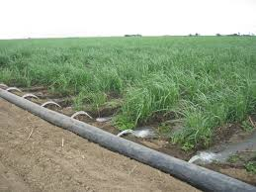
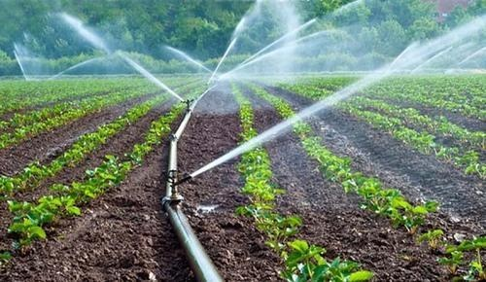
Continued…
Here, we will be discussing about how the modernization and optimization of irrigation systems can contribute to the increase of water productivity in a context of global water scarcity.
Attention will be paid to the role of irrigated agriculture in the satisfaction of the growing food demand.
Modernization and optimization of irrigation systems have often been promoted in public and private agendas as tools to improve irrigation efficiency, producing more agricultural goods with less water input.
Figure 1: Surface irrigation
Figure 2: Sprinkler irrigation

Slide 5
LITERATURE REVIEW
Sl.no | PAPER DETAILS | CONTRIBUTION | DRAWBACK
[1]. | Z. Sun, J. Chen, Y. Han, R. Huang, Q. Zhang and S. Guo, "An Optimized Water Distribution Model of Irrigation District Based on the Genetic Backtracking Search Algorithm," in IEEE Access, vol. 7, pp. 145692-145704, 2019. | In this paper, an irrigation water distribution model based on the genetic backtracking search algorithm (GBSA) was proposed. This algorithm is composed of two main modules, the vector evaluation genetic algorithm and the backtracking search algorithm. | The uniform flow rate is not maintained. GBSA cannot meet the water distribution requirements of the whole canal irrigation system.
[2]. | Suwito, M. Ashari, M. Rivai and M. A. Mustaghfirin, "Energy Consumption of Brushless DC Motor for Modern Irrigation System," 2019 International Seminar on Intelligent Technology and Its Applications (ISITIA), Bali, Indonesia, pp. 105-110. | The energy used in modern drip irrigation systems, is calculated with water pumps driven by Brushless DC motors. Direct water pump method was used with which it can operate at all required water pressures. | Here, the system requires a flow of water with a certain pressure. The irrigation system with overhead water tank requires higher energy.
[3]. | R. Luciani, G. Laneve and M. JahJah, "Agricultural Monitoring, an Automatic Procedure for Crop Mapping and Yield Estimation: The Great Rift Valley of Kenya Case," in IEEE Journal of Selected Topics in Applied Earth Observations and Remote Sensing, vol. 12, no. 7, pp. 2196-2208, July 2018. | In this paper, a remote and automatic agricultural monitoring system is proposed. The phonological profiles extracted by satellite imagery are compared with crop calendar data compiled by FAO for the area of interest. | The combined use of phenological data and AEZs results in a robust methodology with a classification. The overall accuracy is only 50%.

Slide 6
Continued…
Sl.no | PAPER DETAILS | CONTRIBUTION | DRAWBACK
[4]. | RNT Costa, DF Aroujo, Revista, Brasileira de A Macedo “Water Productivity with localized irrigation using groundwater and use water in the cultivation of plant species”,2018. | Water productivity with localized irrigation system with ground water was proposed. To analyze the water saving potential of replacing the traditional, furrow-irrigated banana crop by inserting new cropping plans. | The support capacity of shallow tube wells reveals viable alternative for only the irrigation of small areas.
[5]. | P. Jain, P. Kumar and D. K. Palwalia, "Irrigation management system with micro-controller application," 2017 1st International Conference on Electronics, Materials Engineering and Nano-Technology (IEMENTech), Kolkata, 2018, pp. 1-6. | This paper presents optimized irrigation scheme using automatic water control for performing crop specific irrigation activities. Low cost microcontroller like Arduino based interfacing unit, has been used in this paper to obtain low cost smart irrigation solution. | Uneven water dispersion in cultivation area due to the excess water supply near the canal areas and deficient water supply in areas far from canal. Border strip basin irrigation is complicated and suitable only for few crop yields.

Slide 7
OVERVIEW OF WATER SCARCITY
ADDRESSING WATER SCARCITY:
Modernization and optimization of irrigation systems have often been promoted in public and private agendas as tools to improve irrigation efficiency, producing more agricultural goods with less water input.
However, this represents just one approach to the solution of water problems.
The Available alternatives to overcome water scarcity in a given society includes:
Using more virtual water.
Improve the economic efficiency of water.
Improve the technical efficiency of water.

Slide 8
1. Using more virtual water:
This alternative consists of importing products requiring large amounts of water in their production. All water-stressed countries already resort to virtual water to some extent.
For instance, cereals and wheat flour are commonly imported commodities in dry regions. Middle Eastern and Northern African countries have had a sevenfold increase in these imports between 1960 and 1992.
The virtual water balance of Australia showed a net export of 146,000 hm3 of virtual water, while Spain was a net importer, with 83,000 hm3.

Slide 9
2. Improve the economic efficiency of water:
Societies reassign water uses to obtain maximum return per unit of water. This alternative comprises changes between groups of water uses (usually from agricultural to industrial and urban uses), and within each group.
In the agricultural sector, farmers respond to market rules (among other issues) searching for the highest return per unit land or per unit water, depending on the relative scarcity of both resources.

Slide 10
3. Improve the technical efficiency of water:
The strategy is to perform the same activities, but using less water. Technical efficiency has implications in all water related disciplines, including agronomy and plant breeding.
In the irrigation field this is accomplished by increasing irrigation efficiency.
In order to obtain this goal, there are two different procedures: improving the water structures, and improving water management.
Considering these three alternatives the preferred technical order is coincident with the order of presentation. However, regional decision makers prefer technical efficiency overall.

Slide 11
Continued…
The following is a list of additional (positive) reasons in favor of technical efficiency in the field of irrigation.
• Proper technical management improves the environment, since it effectively reduces the salt and nutrient leaching from irrigated areas.
• The modernization of the irrigation systems adds technology to agricultural production: rural employment becomes more attractive and competitive.
This discussion leads to a prominent role of technical efficiency in overcoming water scarcity. In order to evaluate its effect for a given society, a discussion of water productivity is required.

Slide 12
CONCEPTS OF WATER PRODUCTIVITY AND SCALE CONSIDERATION
Water productivity can be expressed as agricultural production per unit volume of water.
Different water productivity indicators result from choosing different options:
WP1 = Production
(1)
Water used (rainwater + diverted)
WP2 = Production
(2)
Water diverted

Slide 13
Continued…
WP3 = Production = Production (3)
Water Beneficially and Non-Beneficially Consumed ICUC× Water diverted
WP4 = Production = Production (4)
Water Beneficially Consumed IE× Water Diverted
WP5 = Production = RIS× Production (5)
Net Irrigation Requirements Water Diverted

Slide 14
Continued…
The value of the calculated water productivity increases in the sequence WP1 to WP5.Some of the concepts of WP can be interpreted through different forms of technical efficiency:
WP3 is related to the Irrigation Consumptive Use Coefficient (ICUC): The volume of irrigation water consumptively used divided by the volume of irrigation water applied.
WP4 to the Irrigation Efficiency (IE): The volume of irrigation water beneficially used divided by the volume of irrigation water applied.
WP5 to the Relative Irrigation Supply (RIS): Water diversion divided by irrigation requirements or crop evapotranspiration minus effective rainfall.
The pertinence of one or another concept of WP depends on the hydrological domain.

Slide 15
IRRIGATION WATER BASED MODERNIZATION AND OPTIMIZATION ACTIVITIES
Referring to irrigation water, two levels can be identified: the farmer and the irrigation district. A discussion of modernization and optimization activities at both levels follows.
LEVEL-1: IRRIGATION DISTRICT :
Reliability, flexibility and efficiency are the keywords for a modernization plan.
A reliable service allows efficient irrigation management within the constraints of the system.
Moreover, if the irrigation delivery is flexible, the farmer can adapt the irrigation schedules to optimum cropping strategies and tactics that can be adjusted as the crop progresses.

Slide 16
Continued…
The MIP(management improvement program) process incorporates a thorough understanding of the performance of irrigated agriculture in an area, involvement by key decision makers in a joint decision process and implementation of the planned changes by responsible operational managers.
The MIP was defined as a three phase process:
• Diagnostic analysis: The board analyses district performance, resources and limitations and produces a consensus diagnosis of the district status and the aims for the future.
• Management planning: A strategic plan is prepared by the board presenting the basic outlines of the proposed MIP.
• Performance improvement: Activities are developed and a continuous revision process is performed by the board.

Slide 17
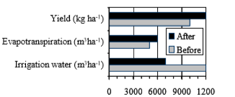
LEVEL-2:ON FARM
As a consequence, changing the irrigation system (from surface to sprinkler) in field crops such as maize in North Eastern Spain often produces results similar to those presented in Fig.3.
A sharp reduction in irrigation water demand can be achieved, following the increase in irrigation efficiency.
A combination of improved irrigation uniformity, the control of the irrigation depth, and a flexible irrigation scheduling result in an increase in crop yield, at the unavoidable cost of an increase in crop evapotranspiration, and in a significant increase in WP2.
Figure 3: Typical changes in irrigation water, crop water use and yield resulting from the modernization and optimization of irrigated maize fields in North Eastern Spain.

Slide 18
Continued…
On-farm irrigation management can also result in increases in WP5.
In the table.1, the comparison of the water productivity of drip and furrow-irrigated cotton is done, concluding that, under full irrigation, WP5 was not significantly different for both treatments.
However, under deficit irrigation, WP5 was notably greater for drip irrigation than for furrow irrigation.
As expected, WP2 was higher for drip irrigation than for furrow irrigation, both under full and deficit irrigation, WP2 was always lower than WP5 as shown in table 1.
IRRIGATION SUPPLY | IRRIGATION METHOD | WP₂ (kg m⁻³) | WP₅ (kg m⁻³)
Full | Drip | 0.79 | 0.88
 | Farrow | 0.52 | 0.90
Deficit | Drip | 1.05 | 1.15
 | Farrow | 0.65 | 1.03
Table 1: Water productivity of drip and furrow-irrigated cotton at two levels of water supply. WP2 is yield divided by applied water and WP5 is yield divided by evapotranspiration of irrigation water.

Slide 19
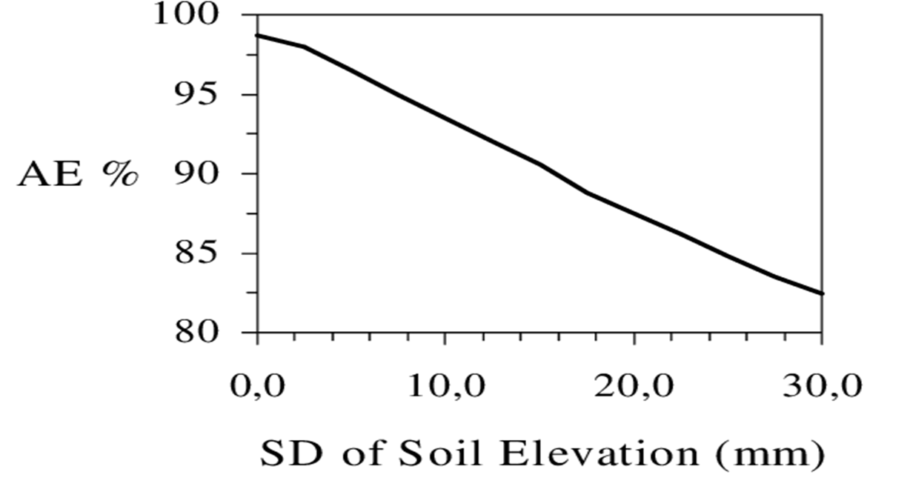
Optimization of Water Management
Management principles can be applied to the optimization of water use in both surface and sprinkler irrigation systems.
In surface irrigation systems, the introduction of laser leveling technique produced a quiet revolution that has raised potential surface irrigation efficiency to the levels of sprinkler and drip irrigation
Figure 4 presents the evolution of the water application efficiency (AE) of a particular case as a function of SD .
The figure reveals that the introduction of laser leveling can result in more than ten points increase in efficiency, while the cost of the leveling operation is two to three times that of a standard tillage operation.
Figure 4: Simulated effect of the quality of land leveling (characterized by the standard deviation of soil surface elevation) on application efficiency in a particular case of level-basin irrigation.

Slide 20
Continued…
In sprinkler irrigation one of the keys to efficient irrigation consists of managing the wind, particularly in windy regions, such as the Ebro Valley of North Eastern Spain.
The adverse effects of wind can be summarized in the increment of wind drift and evaporation losses and in a sharp reduction in irrigation uniformity.
In the Ebro Valley during the night time wind drift and evaporation losses are reduced to approximately one third of daytime losses .
Irrigation machines (pivots and rangers) result in smaller water losses than solid set systems.
The daily evolution of wind speed, combined with the differences between daytime and night time operation, result in differences in water use arising from the time of irrigation

Slide 21
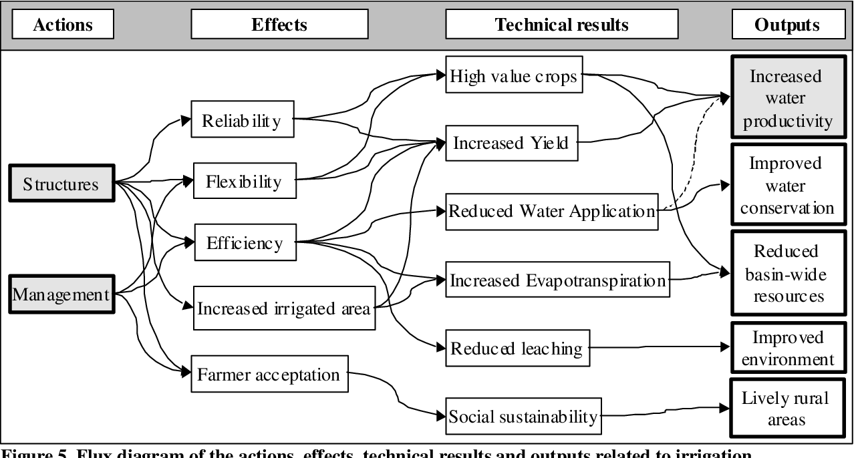
RESULTS
Figure 5: Flux diagram of the actions, effects, technical results and outputs related to irrigation modernization and optimization.

Slide 22
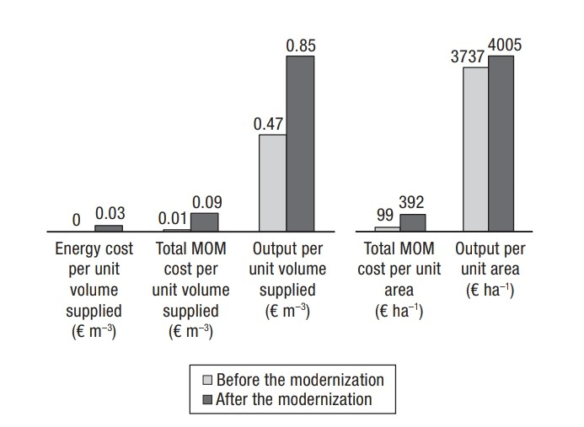
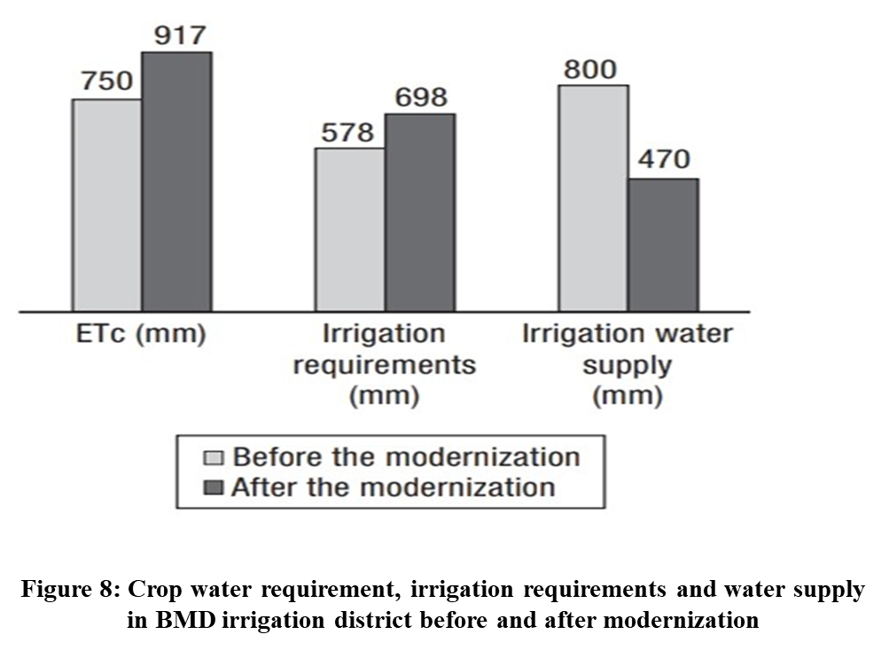
Continued…
Figure 6: Crop requirements, irrigation requirements and water supply in BMD irrigation district before and after modernization
Figure 7: Costs and productivity per unit area and volume supply in BMD irrigation district before and after modernization.

Slide 23
ADVANTAGES OF MODERNIZED IRRIGATION SYSTEM
Areas having scarcity of water can be successfully irrigated.
Increases productivity.
Optimum use of water thus reducing water losses to high extent.
More crop per drop concept can be introduced.

Slide 24
The modernization of the irrigation systems offers the farmers a number of possibilities to expand the economic productivity of water. However, the problem of feeding the world’s increasing demands does not have an easy solution from the irrigation point of view.
Modern irrigation system techniques should be used and promoted because they save lot of water.
Adequate irrigation scheduling can be used to optimize crop yield for a given level of crop evapotranspiration, therefore leading to more yield per unit of evapotranspirated water.
However, the magnitude of such expected improvements is small in comparison with the required increment in global food production.
CONCLUSION

Slide 25
FUTURE SCOPE
The prospects for the future include a sustained increment in yield, some increment in crop evapotranspiration (per hectare), and a sharp increment in global agricultural evapotranspiration. Tensions will increase in many regions of the world, since water will be increasingly scarce, and food demand and production (water availability) will not be coincident in space and time. Virtual water is therefore called to play an even more important role in the future.

Slide 26
[1]. Z. Sun, J. Chen, Y. Han, R. Huang, Q. Zhang and S. Guo, "An Optimized Water Distribution Model of Irrigation District Based on the Genetic Backtracking Search Algorithm," in IEEE Access, vol. 7, pp. 145692-145704, 2019.
[2]. Suwito, M. Ashari, M. Rivai and M. A. Mustaghfirin, "Energy Consumption of Brushless DC Motor for Modern Irrigation System," 2019 International Seminar on Intelligent Technology and Its Applications (ISITIA), Bali, Indonesia, pp. 105-110.
[3]. R. Luciani, G. Laneve and M. JahJah, "Agricultural Monitoring, an Automatic Procedure for Crop Mapping and Yield Estimation: The Great Rift Valley of Kenya Case," in IEEE Journal of Selected Topics in Applied Earth Observations and Remote Sensing, vol. 12, no. 7, pp. 2196-2208, July 2018.
[4]. RNT Costa, DF Aroujo, Revista, Brasileira de A Macedo “ Water Productivity with localized irrigation using groundwater and use water in the cultivation of plant species”.
[5]. P. Jain, P. Kumar and D. K. Palwalia, "Irrigation management system with micro-controller application," 2017 1st International Conference on Electronics, Materials Engineering and Nano-Technology (IEMENTech), Kolkata, pp. 1-6.
[6]. Liu, L.; Guo, Z.; Huang, G.; Wang, R. “Water Productivity Evaluation under Multi-GCM Projections of Climate Change in Oases of the Heihe River Basin”, Northwest China. Int. J. Environ. Res. Public Health 2017, 16, 1706.
REFERENCES

Slide 27
THANK YOU….!

